Slide 1
Richland Academy of Health Sciences
Principal Jon Lobdell

Slide 2
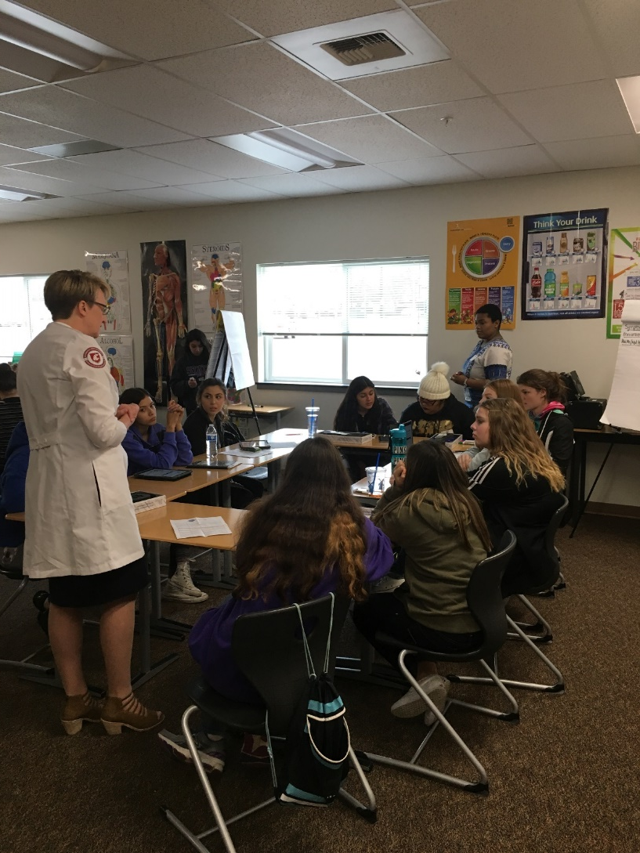
What is the Health Sciences Academy?
Guided Pathways
  Short Term Certificate
  College Credit
  On-Ramps and Off Ramps
  Stackable Credentials

Slide 3

What’s in it for me?
Time and Money
  Low cost or no cost credits earned in high school
  Less time spent in college
  Quicker access to jobs

Slide 4
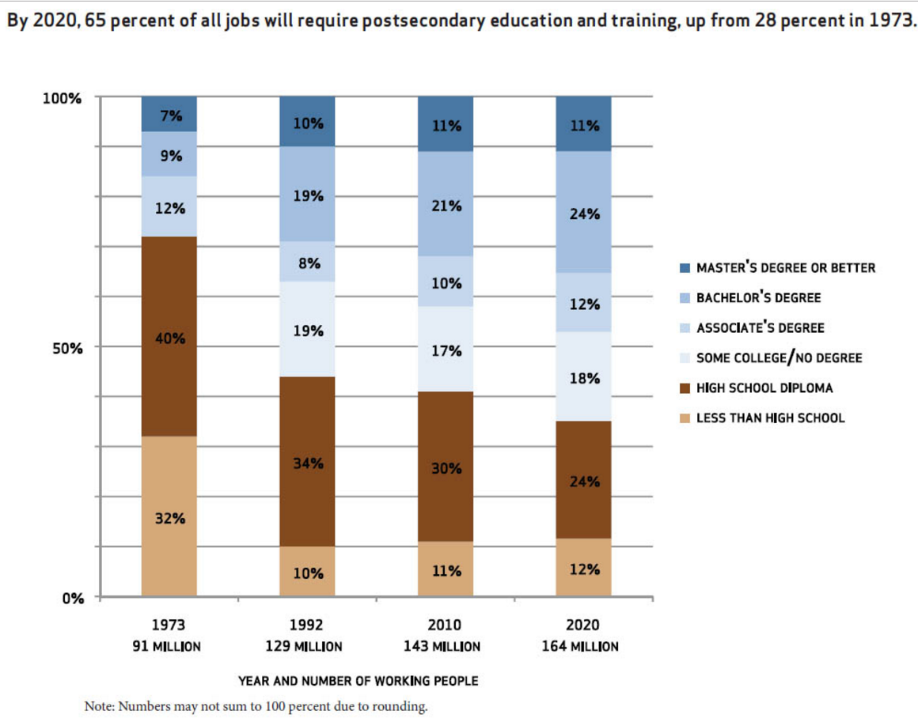
Employment Data
65%
By the year 2020, 65 percent of all jobs will require some form of post-high school education.

Slide 5
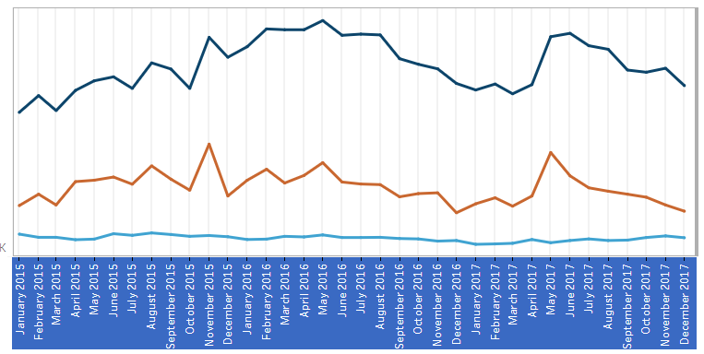

Why Health Sciences?
42% of workforce shortages with average to high demand jobs in Benton/Franklin County are in Health Care and Health Care Support
Notes:
There are currently 132 unfilled jobs at Kadlec in Richland and 43 at Trios

Slide 6
High School and Beyond Plan
WOIS
Directions to a Career in Health
EWU Area Health Education Center (AHEC)

Slide 7
Guided Pathways
Health Science Pathways Recommended and Pre-Requisite Courses
Tri-Tech Skills Center Health Sciences
AP Chemistry
AP Psychology
AP Statistics‡
AP Calculus (AB/BC)‡
AP English Language & Composition‡
College Composition‡
Human Anatomy and Physiology
Introduction to Health Care Careers Medical Terminology‡
Pre-Calculus/Honors Pre-Calculus ‡
Spanish Translation and Interpretation
Speech
Sports Medicine
Written Communications
Dental Assistant
Firefighting
Careers in Health Care
Pre-Nursing
Pre-Veterinary Tech
Occupational and Physical Therapy Aide
Cyber Security
Many of the certificate and degree programs in the CBC Health Sciences Department require courses on this list as pre-requisites to be completed before enrolling in the program. Earning college credit for these classes while in high school may fulfill some of the pre-requisites and may also reduce the number of credits needed to earn degrees or certificates in these programs.
AP Courses may be eligible for college credit ‡ Courses currently providing College in the High School dual credit
Home Care Aide
Medical
Secretary
Medical Records
Medical
Assistant
Health Care
Central
Services
Technology
Phlebotomist
Nursing
Assistant
Transfer or University Program
and Healthcare Information
Certificate
(4 QTRs)
Certificate
(2 QTRs)
Certificate
(4 QTRs)
Certificate
(4 QTRs)
Certificate
(2 QTRs)
Certificate
(2 QTRs)
Certificate
(1 QTR)
Medical Records and Healthcare Information
Medical
Assistant
(Certified)
Radiology Technology
Surgical
Technology
Nursing
(ADN)
Associate in
Applied Science
Associate in
Applied Science
Associate in
Applied Science
Associate in
Applied Science
Associate in Applied Science
(Transfer)
Administration
Nursing
(RN - BSN)
Health Sciences
Pre-Med
Administration Health Care
Health Care
Bachelor of Science
Bachelor of Science Nursing
Bachelor of Science
Bachelor of Applied Science

Slide 8
High School Courses

Slide 9
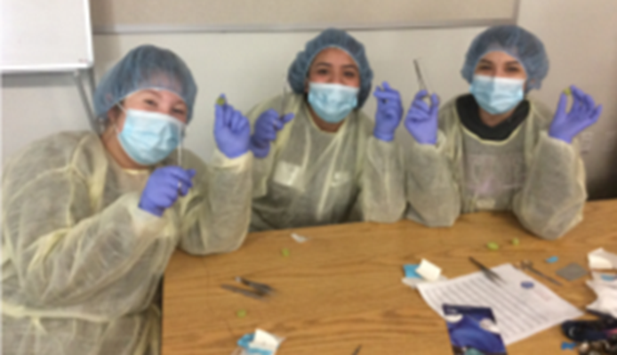
For more information, check with your counselors.
or contact
Mr. Lobdell: jon.lobdell@rsd.edu

Slide 10

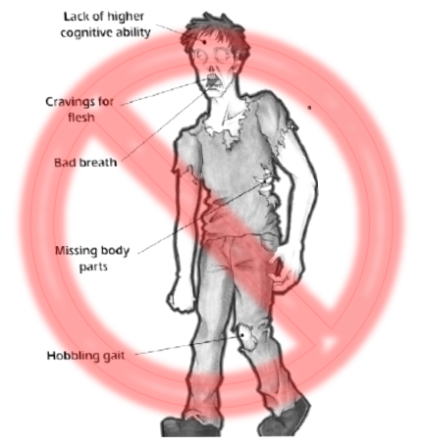
Richland Academy of Health Sciences Summer Camp
Dates: June 18-22 Location: Chief Joseph Middle School
Students currently in sixth to eighth grade are invited to participate in exciting, hands-on learning about health sciences and technology, pre-register and reserve your seat today!
Camp includes:
Hands on learning activities
Guest speakers
Lunch provided daily
Field trip!

