Slide 1

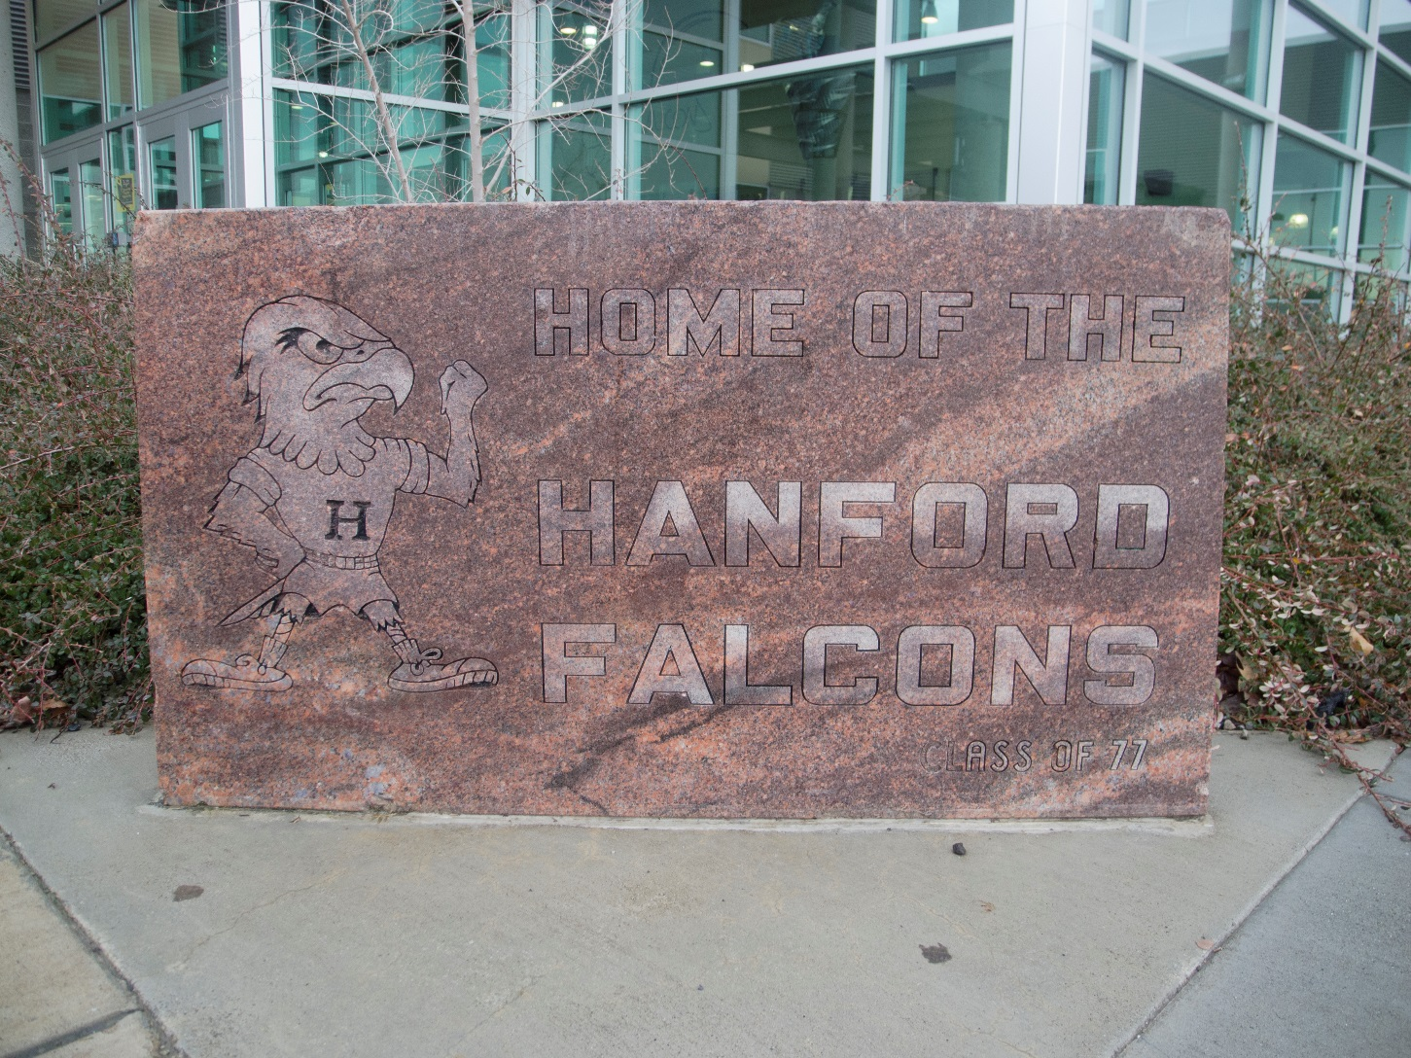
My Freshman Year
Selecting classes for a great year!
Notes:
We are very excited to welcome you to Hanford High School, class of 2020!

Slide 2
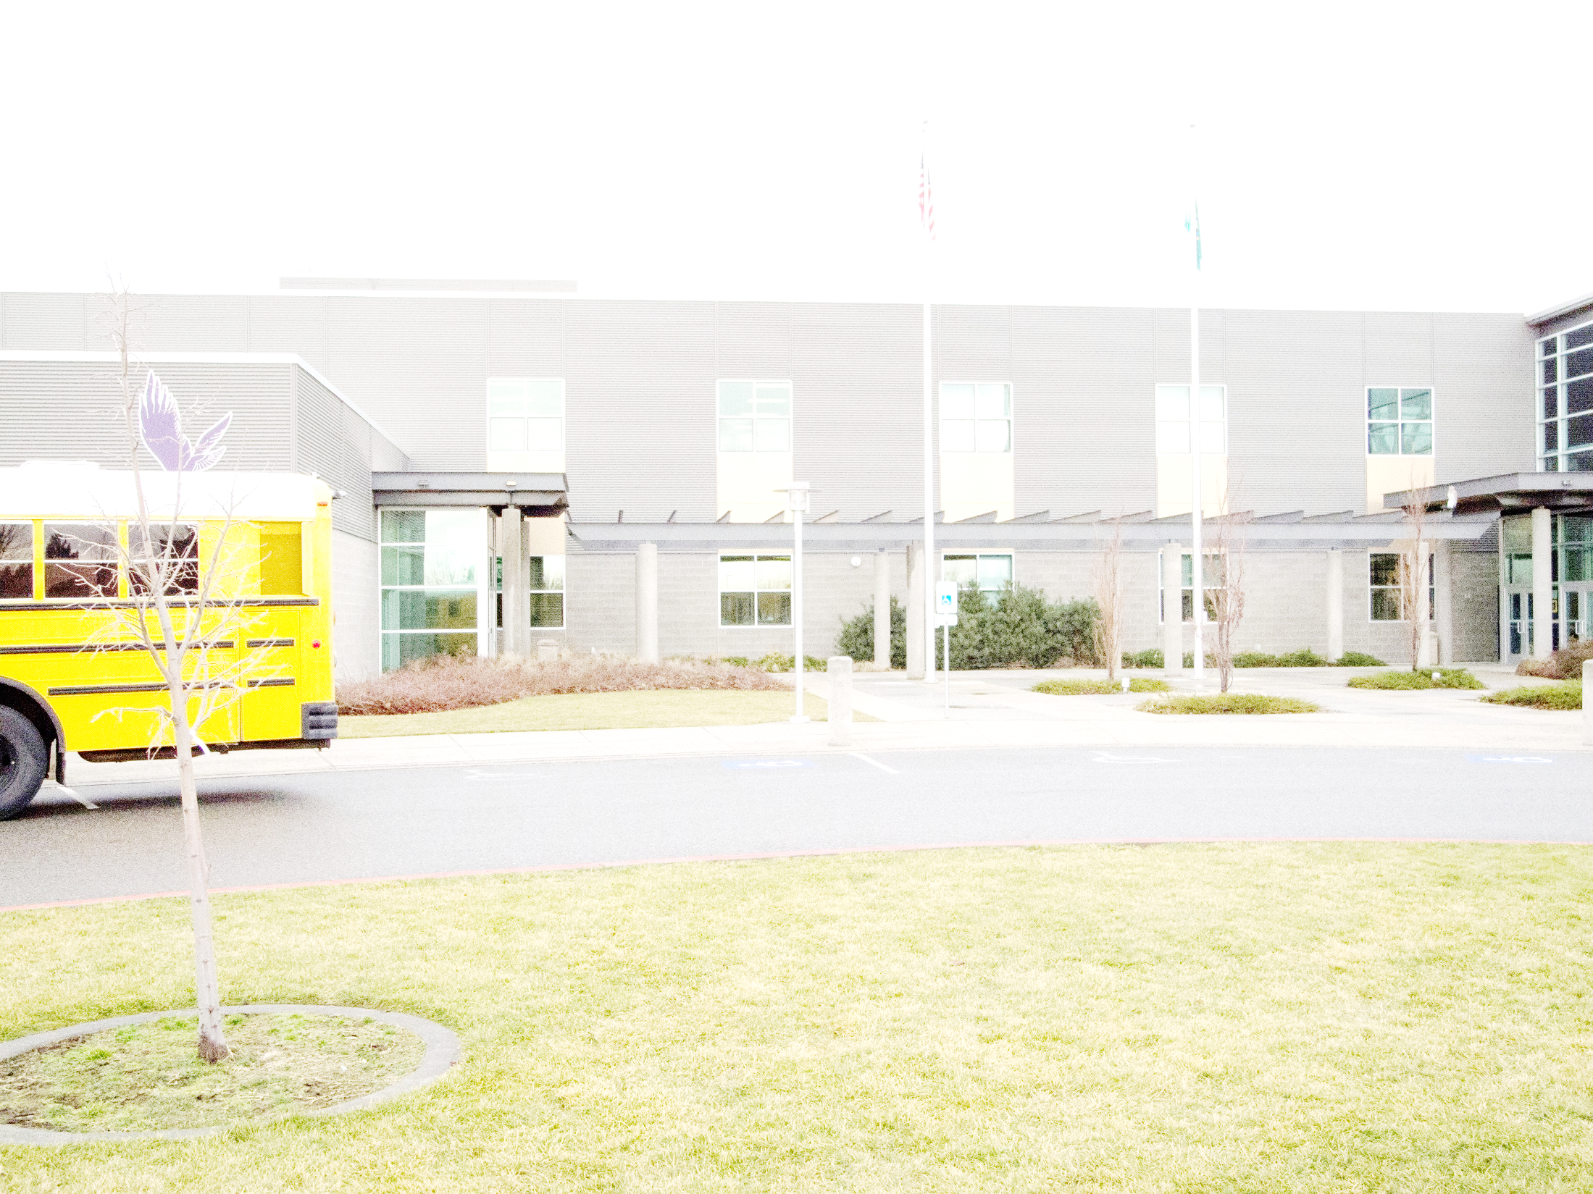
Class of 2021
Credit Requirements
Language Arts – 4.0 credits
Math – 3.0 credits
Science – 3.0 credits
Social Studies – 3.0 credits
Physical Education – 1.5 credits
Health - .5 credits
Fine Art – 2.0 credits
Occupational Education – 1.0 credits
Consumer Economics - .5 credits
World Languages or Personalize Pathway requirement—2.0 credits
Electives – 3.5 credits
Washington State History – Only needed if not passed in Middle School
Total—24 Credits
Notes:
Class of 2021 requires 24 credits for graduation. A year long class earns 1 credit. It is important to pass all of your classes each semester.

Slide 3
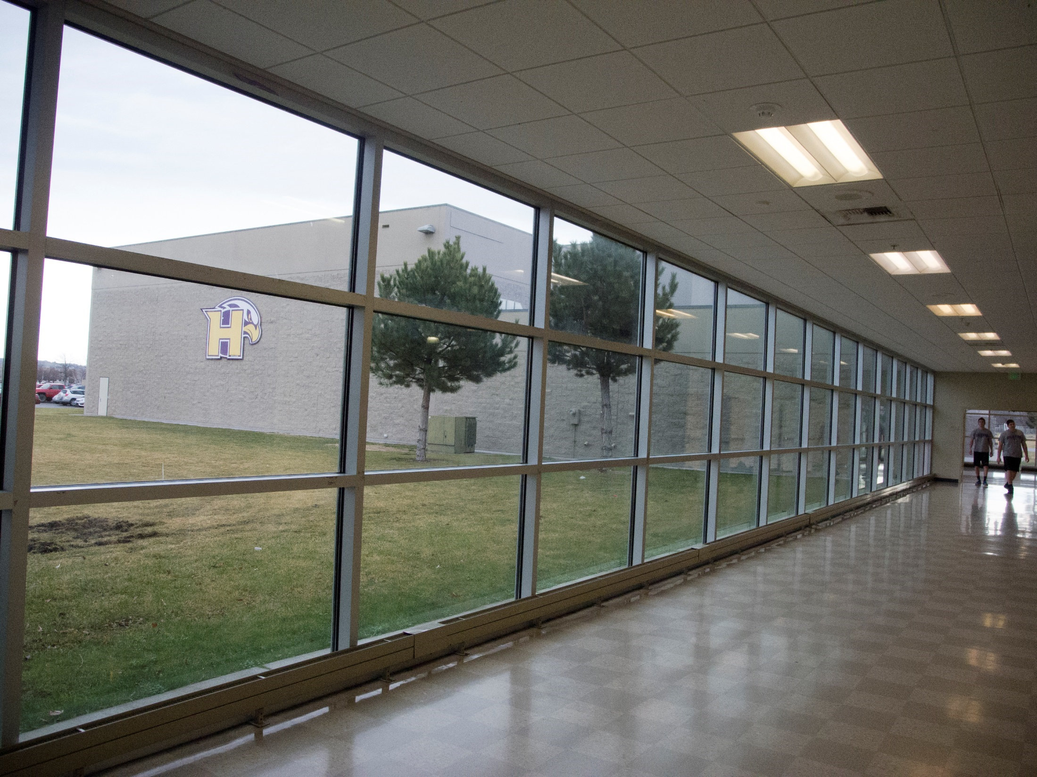
Steps for High School Registration
LISTEN to this presentation – most questions
are answered during the presentation
READ the Course Catalog for class descriptions, fees & prerequisites
TALK with your parent(s) & teachers
THINK about your future & CHECK college admissions requirements
TURN IN your course selection sheet – ON TIME
Notes:
Listen – most questions are answered during presentation
Read – go through first 3 pages with students to show how to find information
alphabetical order
use Art class as example of fee, length of class, grade level, description of class
P. 83 – blank 4-year plan
Talk – experience & knowledge other than your own
Think – it’s never too early to think about where you want to be & how to get there.
Check – admissions requirements & realities may be different/changes
Turn in – to your LA teacher– When is it due?

Slide 4

Course Selections Due
Friday, March 17th
to your Language Arts Teacher!!
Notes:
Ask students to write due date on their course selection sheets!!

Slide 5
Graduation Progress Checklist
Notes:
Page 84 in our course catalog.

Slide 6
9th Grade/Freshman year
Semester 1 | Semester 2
Language Arts 9 or Honors | Language Arts 9 or Honors
Math (Placement by 8th gr. teacher) | Math
Science (Placement by 8th gr. teacher) | Science
World Geography or Modern World or 1 year of AP Human Geography | AP Human Geography
Elective (Fine Art, Occupational, PE, Foreign Language) | Elective(Fine Art, Occupational, PE, Foreign Language)
Elective | Elective
-0- Hour class | -0- Hour class
Notes:
Math will be determined by your 8th grade math teacher
Electives are usually foreign language, fine art class or occupational education.
Share opinion on –0- hour allows students to take band classes or seminary.

Slide 7
AVID
Are you interested in going to a college or university?
Are you interested in improving your organization, leadership and study skills?
Are you an average student wanting to reach your goals through hard work?
If you answered yes to these questions, AVID may be the place for you!
Notes:
Please see your middle school counselor for an application.

Slide 8

AND Remember -
If you don’t select your classes,
I WILL select them for you.
Notes:
If you are not interested enough to make your choices this spring, then you can’t complain next year!

Slide 10

Course Selections due
Friday, March 17th
to your Language Arts Teacher!!
Notes:
Ask students to write it on their course selection sheets!!

Slide 11
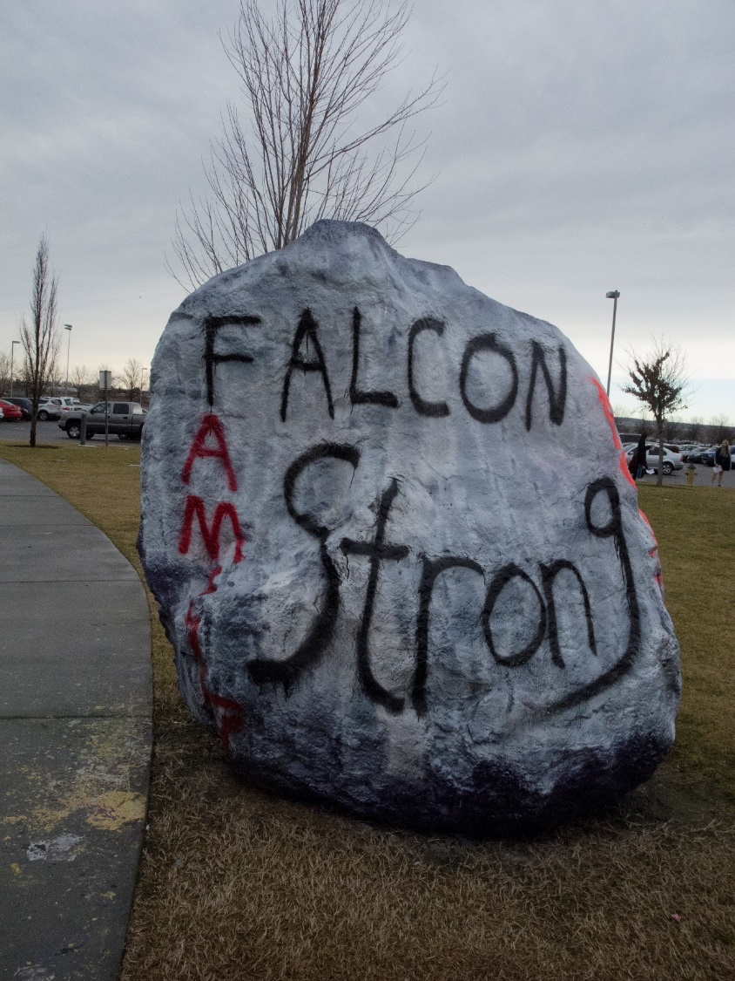
Get Involved
Sports
Clubs
Volunteer
Student Government

Slide 12












Notes:
Get involved – Discuss Sports, Clubs & Activities
Many activities – sports, drama, art, Key Club, music, knowledge bowl, science fair, Math team, DECA

Slide 13
9th Grade Frequently Asked Questions
When is lunch?
We have two lunches based on your class and cannot be changed.
Do I get a locker? Yes – just for you!
Where do I get a PE uniform?
You purchase them from the student store for $18
Should I buy an ASB card?
Yes –if you want to go to football, basketball and other sporting events for free, play a sport, and/or get discounts for dances.
Notes:
Here’s some frequently asked questions.

Slide 14
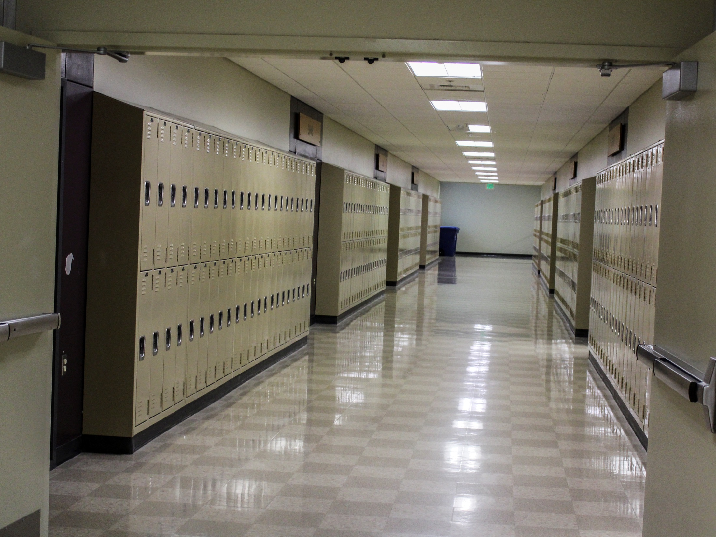
8th Grade Family Night
Wednesday, March 15th
6 p.m.
Hanford High School Auditorium
Informational Sessions and Tour
Notes:
Please come visit next week.

Slide 15
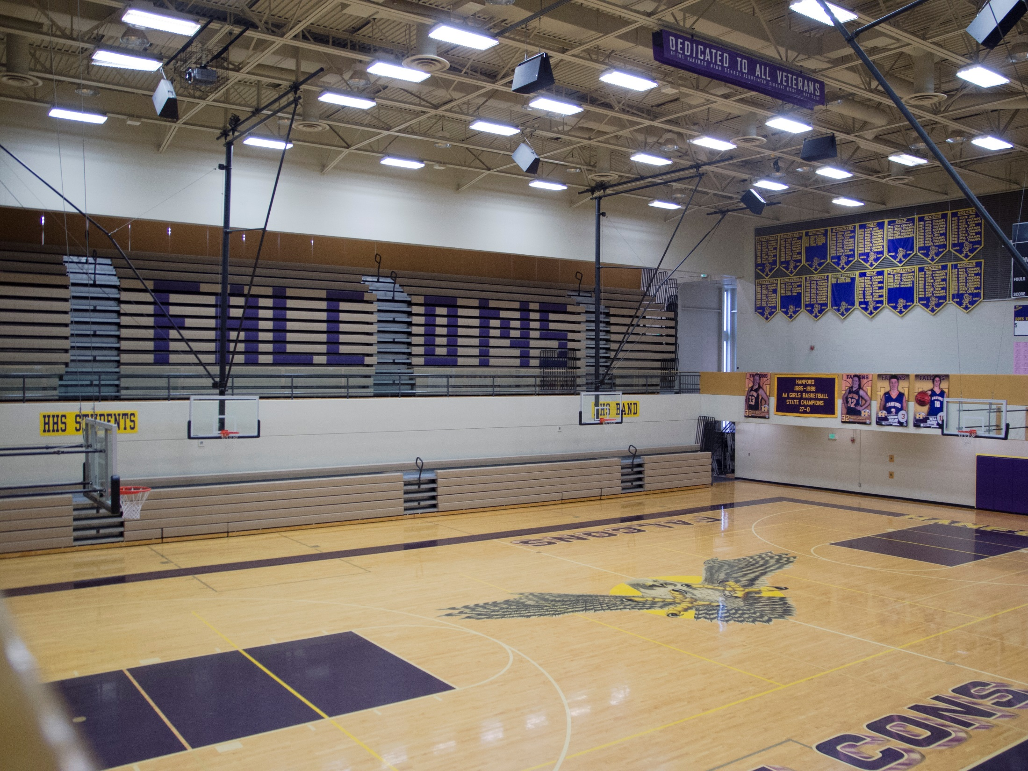
Falcon Prep Day
August 21st
Get your schedule
Get your locker
Pay fees

Slide 16
Freshmen Day
Monday, August 28
Bussing provided
Lunch provided
Meet other freshmen
Visit your classes and meet your teachers

Slide 17

Questions?

Slide 18
Hanford High School
Class of 2021
POST Test
The Hanford High School mascot is
How many math credits do you need to graduate from high school?
When are the Course Selection Sheets due?
How many classes do you have to have in grade 9?
Name 2 clubs or activities at HHS?
What is another name for 9th grade?
How many years of foreign language do you need to graduate from high school?
Can you take high school summer school classes after 8th grade? Yes or No
Notes:
Answers:
Falcon
3
March 18
6
Key Club, sports, drama, band,
Freshmen
2
Yes

Slide 19

24 Credit Magic

