Slide 1

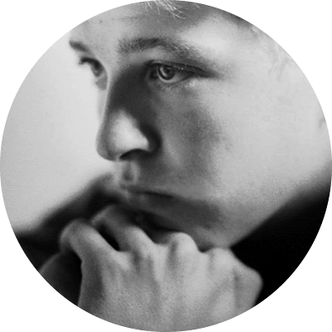
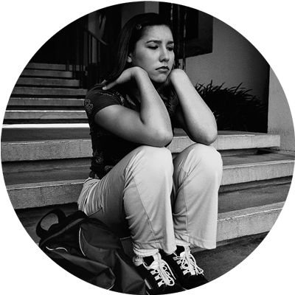
Peer to Peer Training
A Peer’s Role in Youth Suicide Prevention
Notes:
There needs to be a brief introduction of yourself and the program.
**In 1992 a young boy by the name of Trevor Simpson died by suicide. He was an excellent student; came from an intact 2-parent family; played half-back for his high school football team and coached his younger brother’s soccer team. On the weekend of Martin Luther King’s holiday, Trevor went to the Tulalip Indian Reservation and hung himself with the battery cable of his car. His parents were absolutely dumb-founded that he would do such a thing. They wished that no more parents would have to deal with this kind of tragedy and they began to advocate for programs and resources dedicated to suicide prevention. Trevor’s death and their advocacy resulted in funding for a state plan and a program that implements the plan. That is YSPP.
**Today we continue to raise awareness about youth suicide by training educators, students, parents and community leaders to recognize the warning signs and to get help.

Slide 2
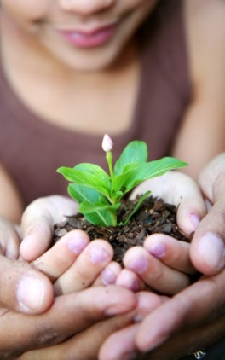
What’s the GOAL?
Recognize when a friend is in trouble;
Know what you can do to help; &
Know where to find that help.
Knowing this could SAVE A LIFE.
Notes:
By the end of this class we want you to be able to:
Recognize when a friend is in trouble
Know what you can do as a friend
Know where to find help
Feel free to ask questions as we go through the presentation.
Suicide is a subject that we don’t talk a lot about. But if we don’t talk about it then we don’t have the information to help friends who are depressed and thinking about suicide. We have to be taught what to look for and what to say. This is not stuff that you just know.

Slide 3
Why we’re here
An average of 2 youth between the ages of 10 and 24 die by suicide each week in Washington State.
15% of WA 6th graders, 17% of 8th graders, 19% of 10th graders and 17% of seniors reported seriously considering suicide in the last year.
Suicide is the second leading cause of death for WA youth.
Peers are an important social network. Many suicidal youth will go to a peer for help before they go to an adult.

Slide 4
Agreements
What will make everyone feel respected and safe in this training?
Notes:
To make sure this presentation safe and helpful for everyone, ask students how they would like everyone to behave or treat each other. List ideas on the blackboard/flipchart.
Include Confidentiality, One person Talking at a Time, and Respectful Communication.

Slide 5

Everyone has stress and problems
Some people have depression and other mental health issues
Fewer people think about suicide
Even fewer people attempt suicide
Fewer
people
die
Notes:
Explain that you want to put suicide in context. If you like to use humor in presentations, first ask that anyone who has never experienced stress or had a problem raise their hand. Make the point that everyone experiences stress, and that when we are scared about suicide we may think that suicide is inevitable when something bad happens to a person, and that that is actually not true.
Click again and explain that the experience of depression or other mental health issues is less common than everyone but still fairly common – it’s estimated that about one in eight adolescents is experiencing depression at any given time, and there are other mental health issues linked to suicide as well.
Less common than that is suicidal thinking. Not everyone who thinks about suicide is depressed and not everyone with depression thinks about suicide.
We also know most people who think about suicide don’t act on those thoughts.
And most people who attempt suicide survive. So we can see that the number of people who die by suicide is way smaller than the number of people who have problems or struggles with mental health.
What we’ll focus on today is how to help a peer experiencing stress, depression, or suicidal thinking and help them stop before that leads to a suicide attempt.

Slide 6

What is STRESS?
The way our minds and bodies respond to challenges and threats
How does stress affect us?
Notes:
If time permits:
Draw person on board with bubble over their head. Stress has direct effect on our bodies and minds.
Volunteers come up and draw/write physical or mental effects of stress.

Slide 7
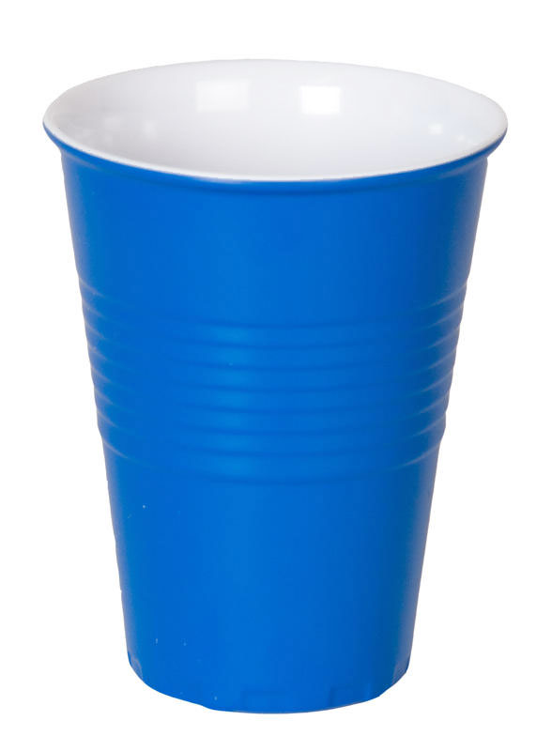
Stress Activity
Think about stressors teens have… a problem, a worry or just a concern…
Each cup will represent a unique stressor.
Notes:
Ask for a volunteer to come in front. Explain we will be brainstorming sources of stress, or stressors. For each one you will hand the volunteer one cup. Explain that the person must hold the cups in their arms and can’t stack them.
Keep soliciting ideas from the group until the volunteer can no longer hold all the cups. Ask the class what they saw happen and emphasize that the person was overwhelmed by stress, and that everyone feels that way sometimes but feeling that way often is a sign of a problem.

Slide 8

What is Depression?
Feelings of intense sadness that last 2 weeks or longer and keeps a person from functioning normally
A treatable illness that is not the person’s fault
Causes:
Brain chemistry
Situations and experiences

Slide 9
Signs of Depression
How can you tell a peer is depressed?
Irritability
Changes in eating/sleeping habits
Physical complaints
Poor school performance
Moodiness, hopelessness, withdrawal
Substance abuse

Slide 10


Getting Help for Depression
Safe, confidential place to talk
Get an outside opinion
Learn new coping skills
Get the care and support you need
https://www.youtube.com/watch?v=XzjBHaT6htU
Notes:
Most young people who experience depression do not get help. Ask the group to brainstorm reasons why.
What keeps people from getting help?
Why is it worth it to get help?

Slide 11
Suicide Risk:
Who is more vulnerable?
People with depression and other mental health issues
LGBTQ youth
Boys and men
Youth who abuse alcohol or drugs
Native American youth
People who’ve experienced abuse or trauma
Notes:
A little simplified, but when someone is vulnerable, then experiences a crisis, doesn’t have the help and support they need, is a time that they’re at higher risk of suicide.
It does not mean a vulnerable person who has a problem will inevitably be suicidal.

Slide 12
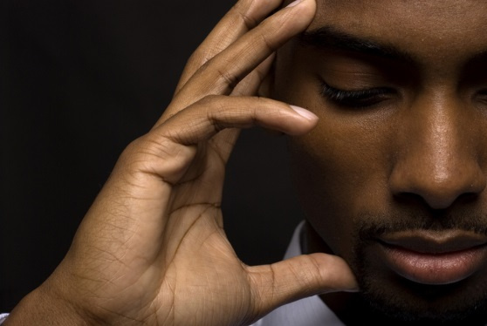
Suicide Risk:
What experiences might be triggers?
Ongoing Stress – bullying, abuse, isolation
Death – family/community member, friend, pet
Breakup
Family Conflict – chronic and persistent
Another stressful event – Getting arrested, experiencing violence, moving to a new foster home, failing a class or unplanned pregnancy

Slide 13

Signs of Suicidal Thinking
FACTS
Feelings: Sad, lonely, hopeless, in pain, moody, irritable, increased depression
Actions: Pushing away friends and family, giving away important possessions, using alcohol or drugs, making unsafe decisions, making or researching suicide plans, making art or writing about death, saying goodbye
Changes: Changes in school performance, changes in appearance or hygiene, changes in personality or attitude, just not seeming like themselves
Threats: Saying they’re going to kill themselves, saying goodbye
Situations: Has the person had a crisis or trigger situation, especially in the
last couple of weeks?
Notes:
Before showing slide, ask if anyone has been concerned about someone who might be suicidal. Ask for input on how they knew – what did the person say or do that concerned you?
Then go through the FACTS framework.

Slide 14

Youth Suicide: Intervention Steps
Show you care
Ask the question
Call for help

Slide 15
PEER
ADULT
Be a good friend
Educate yourself
Take it seriously
Link to someone
who can give more help
Show you care
Don’t keep
dangerous secrets
Know what to look for
Offer support
Listen
Assess danger
Ensure safety
Teach skills
Provide mental health care
Notes:
Talk through the content on the slide:
Let’s take a look at your role in helping a friend who might be at risk for suicide.
If you have a friend thinking about suicide or who has talked about it – it is serious! You have a role to play in helping your friend, but it is not to be the adult or to be a counselor.
There is a very important role for a friend that includes being a good friend and educating yourself about suicide so you know what to look for and when to be concerned.
The adult’s role is also to be able to assess the seriousness of the suicide talk. When the crisis has resolved they can also teach new skills for coping and dealing with the depression
There are also some things that both roles are responsible for which include some intervention steps that we’ll talk about next. We want you to understand that you need to get them to someone who can help and not try to be the counselor yourself – they need you to be their friend.

Slide 16

What to do
Show you Care
Ask the Question
Get Help
Notes:
What to do if a friend is saying or doing things that make you think they might be thinking about suicide. 3 simple steps. Something anyone can do, even a person your age. Describe the three steps.

Slide 17

SAG
Show You Care
“I am concerned about you because…”
“I want to help”

Slide 18

SAG
Ask the Question
“Are you thinking about suicide?”
Notes:
Has anyone asked someone this question? What did it feel like to ask? To say the word Suicide?
Asking this question will NOT make someone suicidal. Most people will tell the truth when asked directly.
This is the only way to be sure whether the person is thinking about suicide.

Slide 19
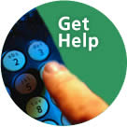
SAG
Get Help
Do NOT leave this person alone.
“You’re not alone. Let me help you find some help.”

Slide 20
Where to Get Help
School Counselors, Mental Health specialists
Physicians/health care providers
Teachers, Coaches, Parents, Clergy, Youth Leaders
National 1-800-273-8255 Local 783-0500 Crisis Lines
1-866-TEENLINK (answered by teens)
LGBTQ friendly services 1-866-4U-TREVOR & Trans Lifeline 1-877-565-8860
Text Crisis Line 741-741 “start”
Notes:
It's important to identify LGBTQ friendly resources in your community.
Also, let all youth know that you are a GLBT “ALLY”-that way questioning youth know that you’re a safe person to go
Public Health's 2015 Safe Storage Saves Lives Campaign
http://www.kingcounty.gov/healthservices/health/injury/lokitup.aspx

Slide 21

Scenario for review
© YSPP
Notes:
Select one of the scenarios that best fits your group.

Slide 22
CARLOS
Early in the fall, your friend Carlos’s father was very ill. During that time, Carlos spent a lot of time in the principal’s office, in trouble for minor disciplinary problems. His behavior has improved, but you have noticed him acting quiet and serious in class, and he told you that he was going to drop out of his community soccer team because there was too much on his mind.
For about a month, Carlos has been dating Jamie. He was very invested in the relationship, and you heard him say he would want to die if the relationship ever ended. Today you learn that Jamie broke up with Carlos. You are going to see him next period at lunch. What will you say to Carlos?

Slide 23
What are the FACTS?
Feelings
Actions
Changes
Threats
Situations
Notes:
Have students work in small groups/pairs. Go through FACTS sheet. One student from each team report out.
What feelings, actions, changes, threats, and situations did they see that are concerning?
Ask if they think _______ MIGHT be thinking about suicide. (We want them to get to a yes answer)

Slide 24

  Show you care
  Ask the question
  Get help
Notes:
Now in your pairs/small groups, discuss and say out loud…
1- How you would use the 3 steps with Carlos?
2- Who would go to for help?

Slide 25

Remember…
Youth suicide is a big problem in Washington
Most young people who experience stress and depression do not attempt suicide
Many teens in crisis go to a friend first. You are a key part of the support network!
Using SAG and connecting your peers with a helpful adult can save their life, BUT…
Another person’s choices are not your fault.
Notes:
Emphasize the last point. While it’s important to do what you can, you are not responsible for another person’s choices.

Slide 26
Suicide Prevention Awareness
What can you do in your school and community to promote suicide prevention?
Remember: Keep it PREVENTION focused!
Notes:
Here is a list of what the youth can do in their school and community to promote suicide prevention:
Information table with resources at lunch or other appropriate events
Put up posters around the school
Hand out yellow ribbon pins for awareness
Check our school’s Healthy Youth Survey and use statistics from that to raise awareness
Use sidewalk chalk and write statistics and ways to help around school
Coordinate a parent information night and have a youth panel
Make announcements over school intercom or through video announcements
Write an article for the school newspaper
Do a fundraiser (dinner, silent auction, that will benefit a suicide prevention organization (doesn't have to be us :-)
Coordinate a parent information night (could include more than just suicide)
Coordinate staff/teacher training
Distribute brochures and posters to local libraries and other places were youth frequent (youth centers, boys/girls clubs, YMCAs, etc)
Remember: Keep it PREVENTION focused! Although recent losses in our community have left a huge amount of pain and grief, it is important for the safety of other community members that we focus on hope and prevention, not those stories of loss.

Slide 27
Closing Activity
How did you feel about P2P when you arrived today?
How do you feel about P2P now?
What was your favorite part of the P2P Training?
What will you change now that you have been through this training?

Slide 28
Contact Information
Kristi Haynes
Benton/Franklin Field Coordinator
Kristi@yspp.org

